Slide 1
Popularity Meter

Slide 2
Popularity Meter
In our Project we displays celebrities, politicians, company status from different media and social medias into one application.
This project is developed for Analysis the usages of clients( likes, followers and post) such as company's, politicians and celebrities.
It displays the usage analytics into a diagrammatic representation.
Client status collection is our first step from social medias.
Main social medias we prefer are Face book , Twitter etc.
Categorizes the status by client names and display.
We can find clients updates in all medias in this app.

Slide 3
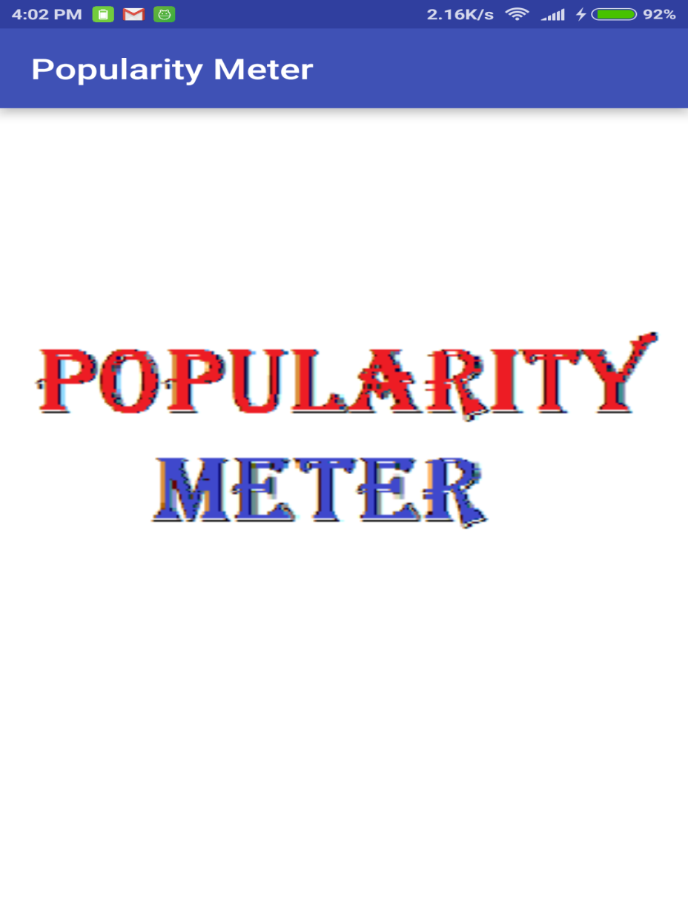

Slide 4
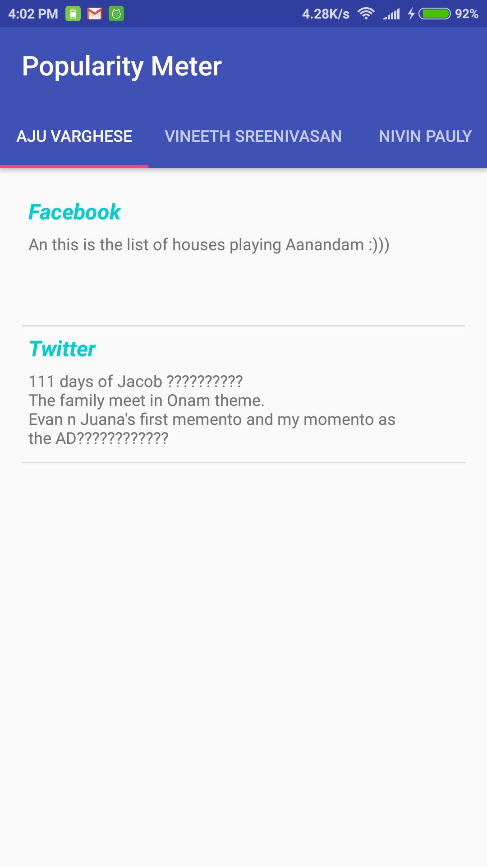

Slide 5
